Slide 1
ORITTO Website + Store Sitemap
Domains to be linked
oritto.com
oritto.in
oritto.co.in

Slide 2
Website Brief
ORITTO is planned to be a confident Consumer products brand and should be worked upon like one. A vibrant yet professional webpage design so as to make an impression of ORITTO LED Lights as a young and solid upcoming brand with solid product base. Emotional connect should be developed while drafting copy for the website. ORITTO is planned to be a consumer products brand so the treatment should be accordingly planned.
Integration with Social Media namely - Twitter, Facebook , Linkedin, Youtube, Videeo….Whatsapp Integration
Website should be designed in such a manner that the visitor should be able to make a purchase decision from each of the current page possible.
Responsive Template and Theme as per international standard.
Product listing and Search. Implement Dynamic features for manage Category, Sub-category, Products online Enquiry etc.
Website should be designed in such a manner that the visitor should be able to make a purchase decision from each of the current page possible.
Web analytics of website visitor’s geography and other profile wise.
End user registration facility
Blog
Admin Module
For website, regular updates.
• The admin user should be able to make any changes needed in technical specifications as and when required on his own rather than depending on the technical team
• Products Updates (Products picture, Name, Price, Description, Discounts etc.)
• Add/Edit products and website content
• Online enquiry and notification alert
• Provide Training for products listing and admin module.
• Customer Management
Pages will be considered completed only when the pages are good to go live.

Slide 3
One time SEO activities
Indicative though not limited to
Strict NO for Just page no. wise indexed pages
SEO perspective should be top priority for copywriting.
a
titles
b
Keywords. The pages should contain key words for SEO
c
URL structure
d
Internal Linking
e
XML Sitemap
f
HTML sitemap
g
Robots file
h
Image optimization
i
google analytics code integration
j
google webmasters code integration

Slide 4
ORITTO LED LIGHTS
Corporate
Banners (3-4) high resolution with Oritto mother image
Oritto world animation
About Oritto - Journey like how did it start - what was the idea - what were the challenges - evaluation of manufacturing setup - Differentiator points about oritto - services provided.
Vision, Mission, Values
Journey/milestone
Manufacturing Excellence through Backward Integration
Manufacturing Plant - Pictures of factory, process units, with overall explanation
Process flow chart or Infographic
Why Oritto?
Global Presence
Certifications
Management Team - Oritto Pillars / Team
Clientele (sideways scrolling ticker)
Gallery
Footer - Contact Us
Products
Ceiling Luminaires
Surface Luminaires
Panel Luminaires
Bulbs
Battens
Wall Luminaires
Bulkheads
CoB Luminaires
Mirror Luminaires
Cabinet Luminaires
Smart Luminaires
Emergency_Inverter Luminaires
Facade Luminaires
Road Luminaires
Flood_High Mast Luminaires
High-Bay Luminaires
Flame Proof Luminaires
Bollards
Post Top Lanterns
Swimming Pool Luminaires
Designer Poles & Furniture
Footer
3. Solutions
Residential & Apartments
Offices (Banks, Hotels, Hospitals & Schools)
Retail & Museums
Pharma, Operation theaters and Cold Storages
Entertainment & Sports
Ports and SEZs
Airports, Metros and Railway Stations
Industrial and Warehouses
Architectural Monuments
Landscape
Swimming Pools
Emergency & Exits
Footer
4. Solar
Solar Street Lights
Semi-Integrated
All-in-One
Hybrid
Solar Mini Mast
Solar High mast
Solar CCTV Cameras
Solar Traffic Blinkers
Solar Mobile Lighting Towers
Footer
5. Offers
6. Support
Sales Enquiry
Service Request
Contact us
7. Distribution Enquiry

Slide 5
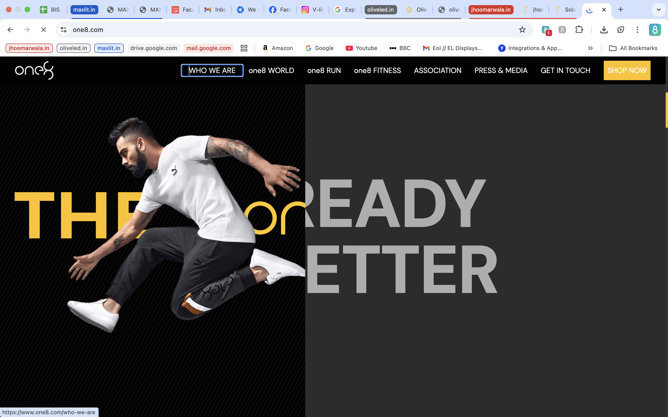
Home Page needs to be absolutely brilliant and high energy and sharpness - Similar to One8 https://www.one8.com/. We need to have an animation for t

Slide 6
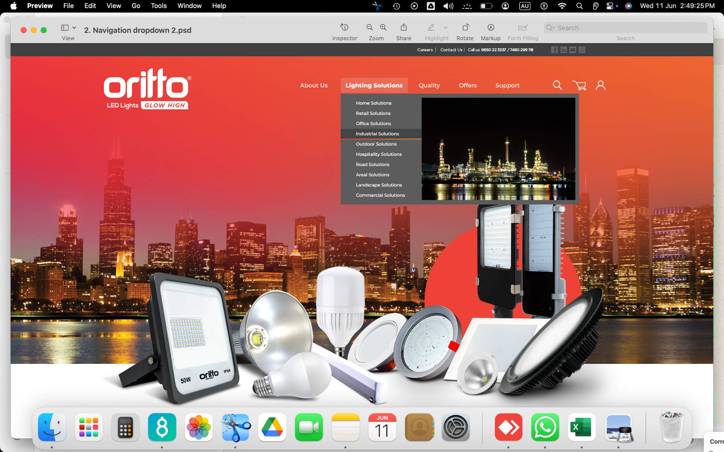
Header
Company Products Solutions Solar Support Distribution Enquiry

Slide 7
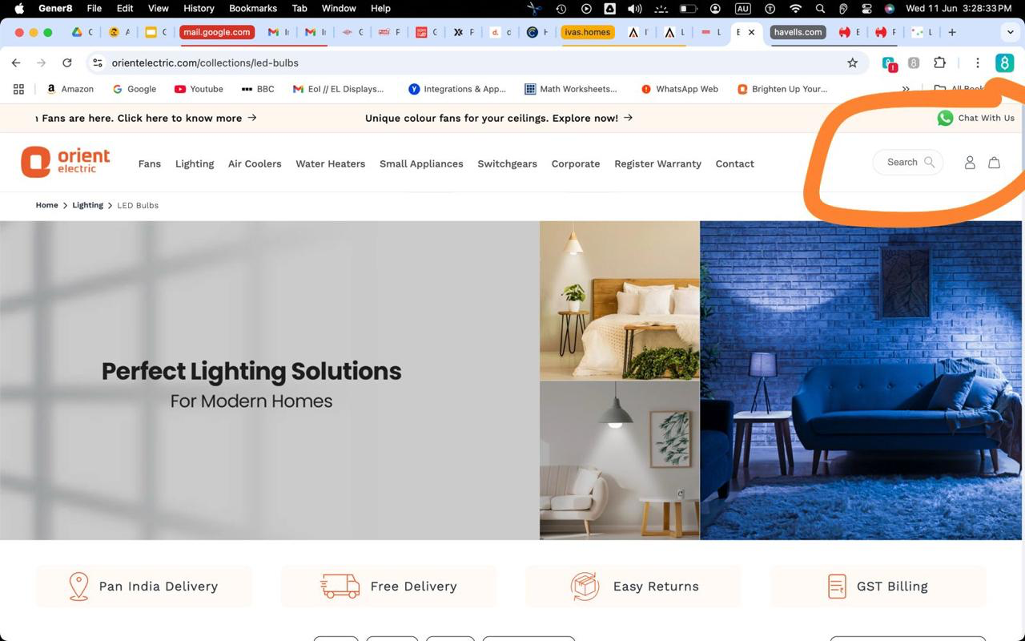
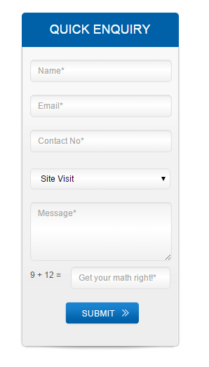
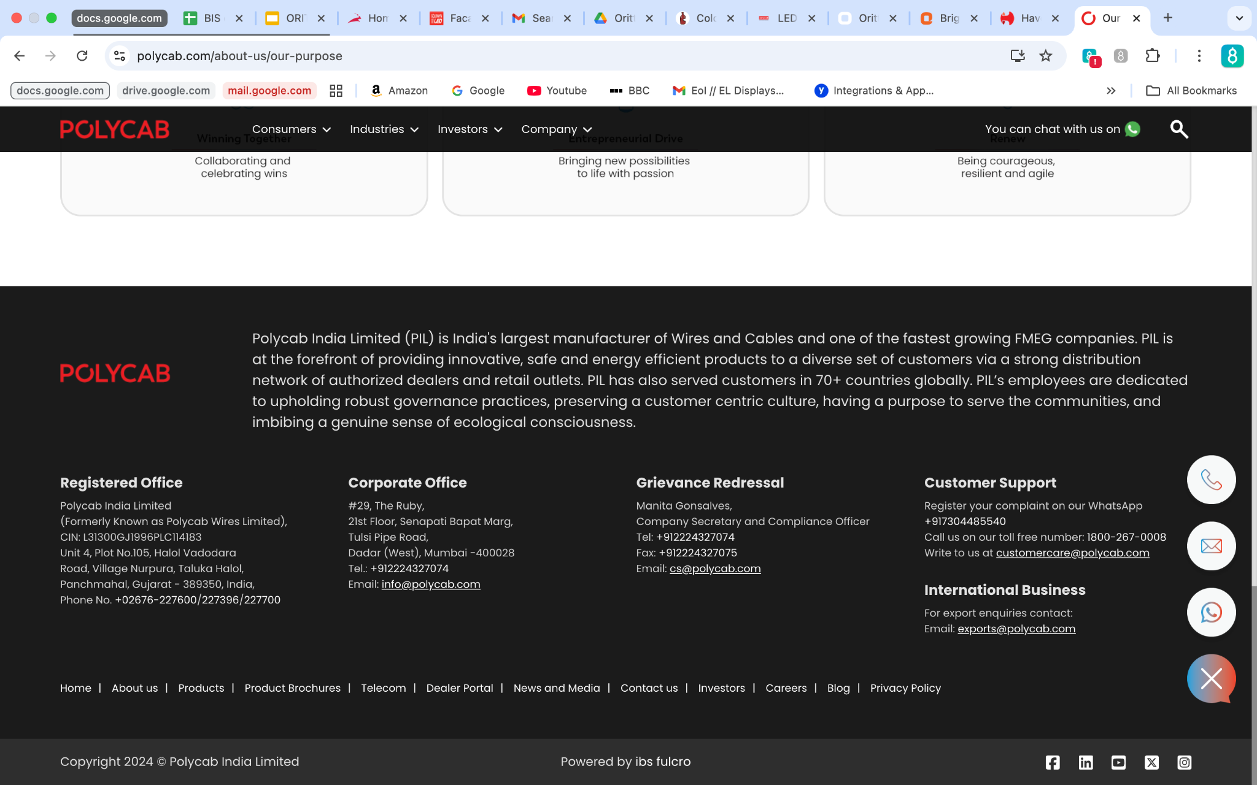
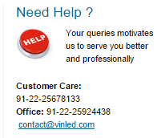
Search box to be provided at top right
Chat with us to be hanging on current screen all the time.
Enquiry box to be hanging at all times on each page being navigated without the need to go to contact us page.

Slide 8
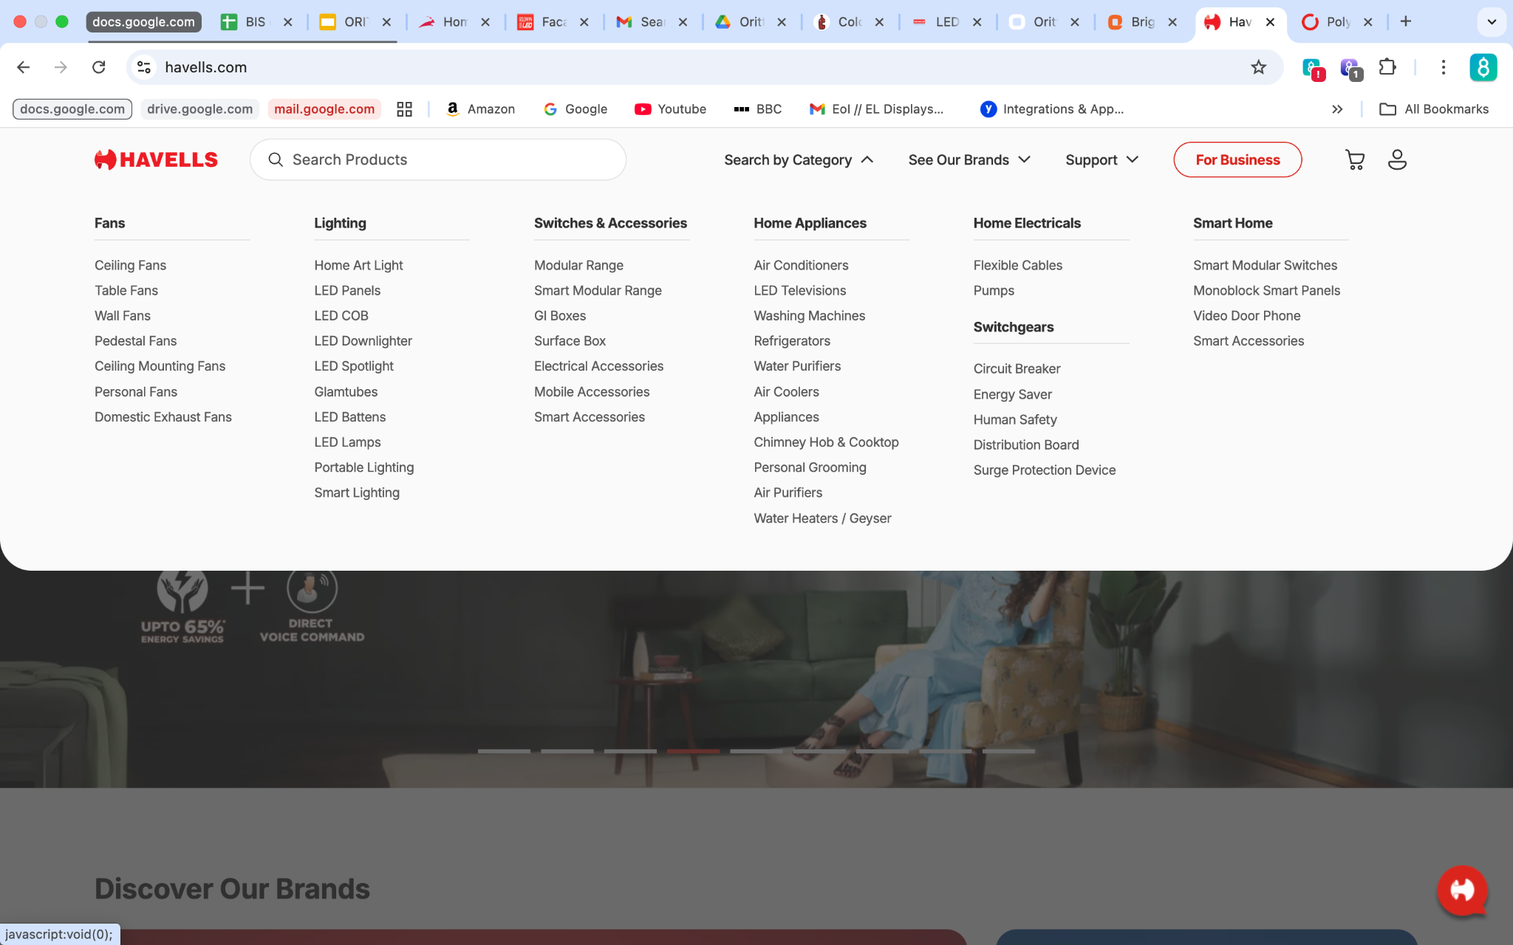
Menu drop down to be something like this both Products menu and Solutions Menu

Slide 9
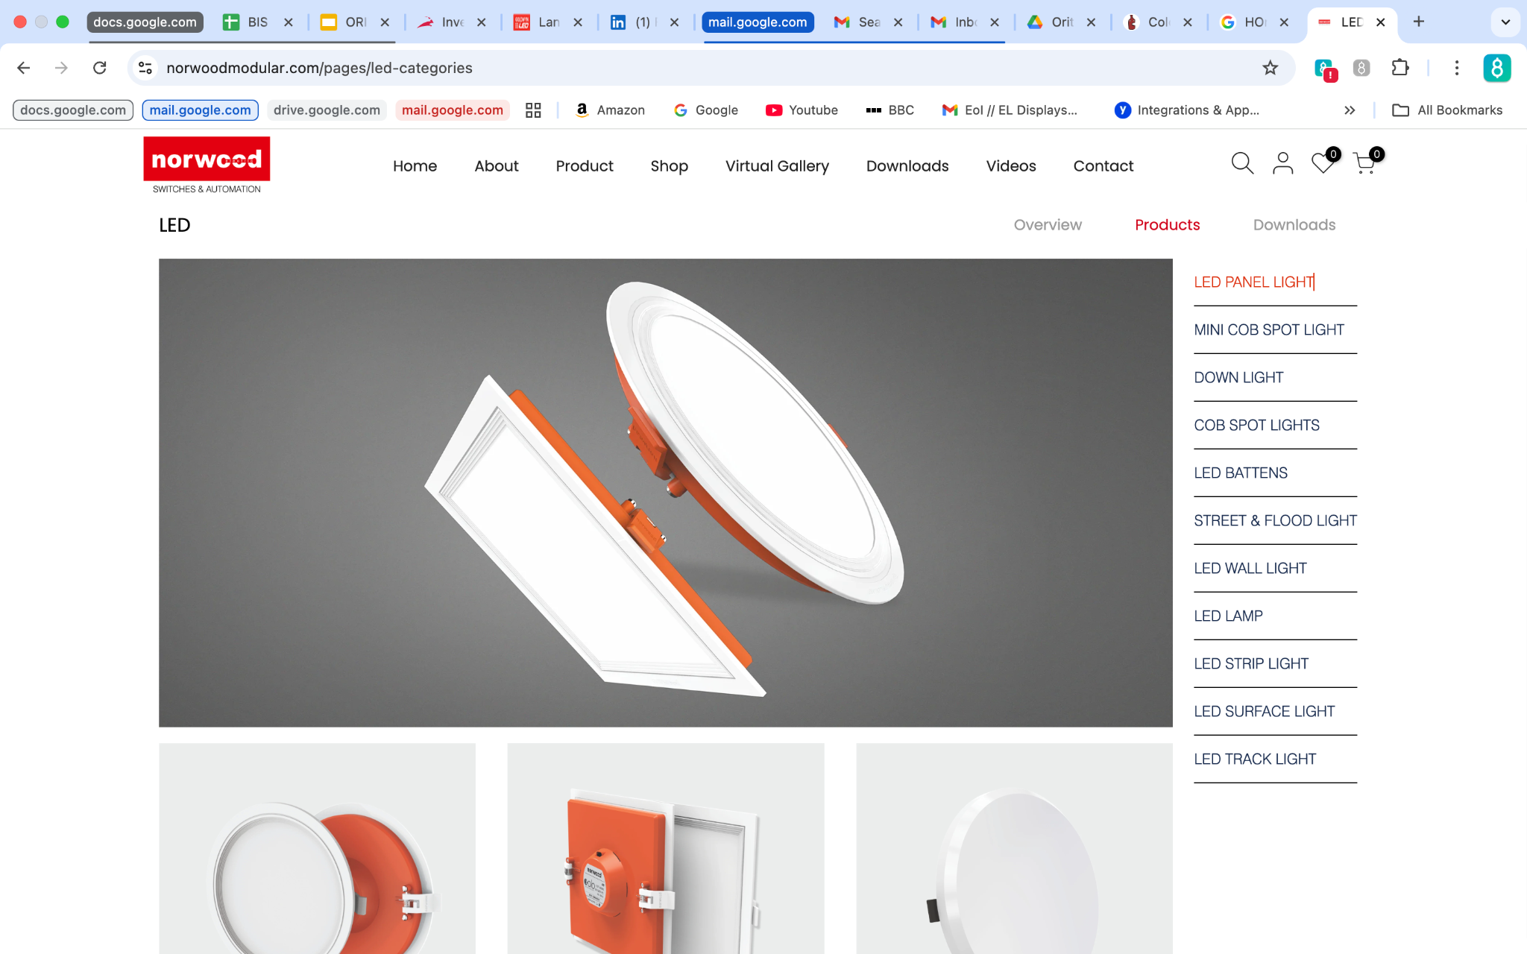
Navigation tabs feature needed at following locations
Ref: https://norwoodmodular.com/pages/led-categories
Product category Switching
Product Models Switching
Product Application Switching

Slide 10
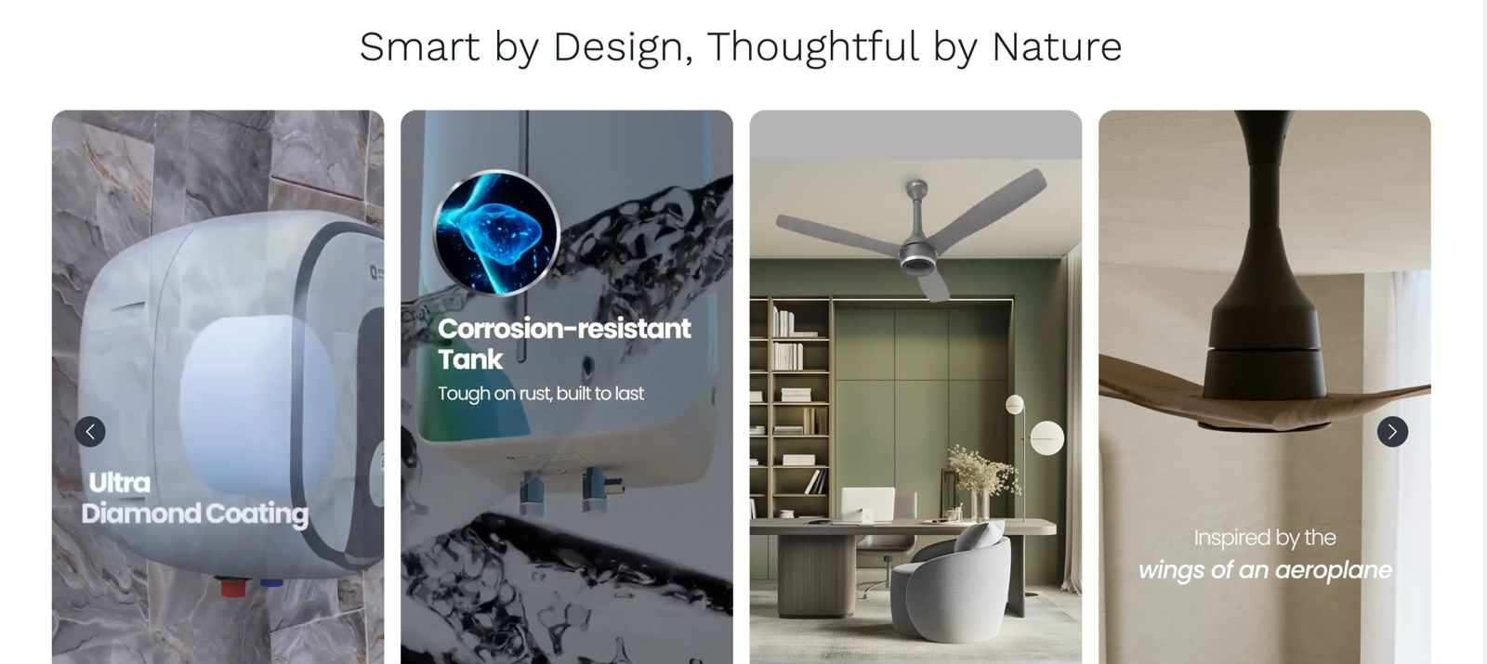
Solutions on scrolling page
Ref: https://orientelectric.com/pages/lighting

Slide 11
Support
Support page should cater to Three types of requests
Ref: https://polycab.com/contact-us/support
Sales Enquiry
Service Enquiry
Contact Us
Downloads
Product Catalogs
Consumer Luminaries
Professional Luminaries
Architectural
Solar
Landscape
Policies
Warranty Policy
Return and Replacement Policy
Service Request
2 drop down menus with selectable options required
Customer Type
Distributor
B2B
B2C
Institutional
Request Type
Inspection Request
Service Request
Message/Issue :
Track Complaint
2 Text Boxes Required
Ticket no.
OR
Mobile No.
Grievance Redressal
In case of any grievances for purchases made on E-Commerce platforms, please contact:
After Sales Support (support@oritto.com)
If your query is not resolved in 14 days, please contact:
( grievance.officer@oritto.com )
Working hours: Monday to Friday 10 am to 6 pm
Sales Enquiry :
Request type:
Name
Mob./Contact:
Address:
Country : Drop down (India , Others)
State (All active states)
City (All cities as per state selected)
Message :
Contact Us:
Registered Office/Plant:
Prabuddha Power
Plot no. E-1(D), New II Industrial Area,
Opposite MPEB Substation,
Mandideep
BHopal
Madhya Pradesh
India - 462046
Phone Numbers
Tel No: 07480 - 49398
Toll Free No: 1800-889-4722
WhatsApp No: 9993971796
Email Address
Service Request, Quality & Product complaints: support@polycab.com
Sales Enquiry: sales@oritto.com
Distributor/Dealership Enquiry: info@oritto.com
Invester Relations Enquiry: info@oritto.com
Exports Enquiry: exports@oritto.com

Slide 12
Distributor Enquiry
(Please fill the details in capital letters)
Enquiry Type : Drop down (Depot/Distributor/Dealer)
Business Entity Name:
Owner/Promotor Name:
GST no.
Contact no.
Email ID:
Country :
State
City
Town
Address:
PINCODE
Years of experience in Business
Annual Sales/turnover of your Business
Proposed Investment
Message:

Slide 13
Shop
We don’t want to have our own shopify or any other store as of now…

Slide 14
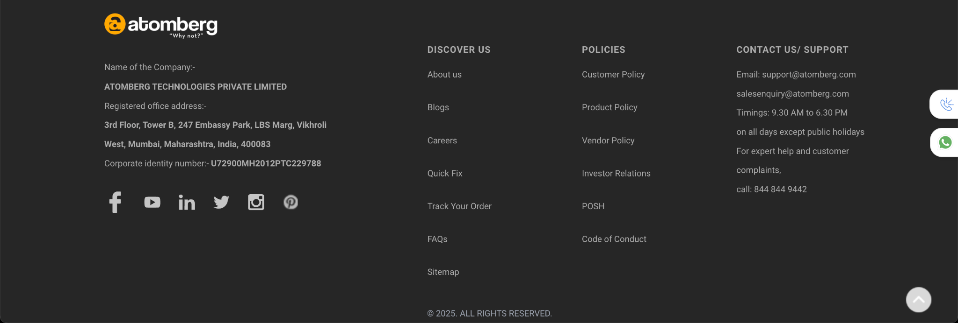
Footer
Footer should have the complete Site map at the bottom aliong with Contact us/Suppprt Details and Social media icons

